Slide 1

Cadence
Full-Custom IC Design
One Chip Design
SHIN HONGMIN

Slide 2
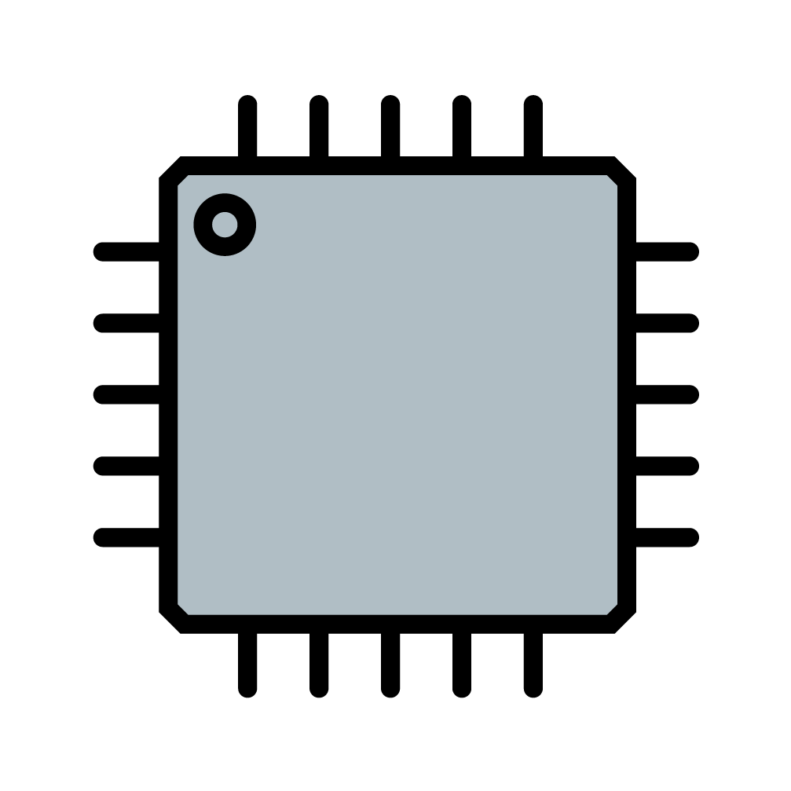
INDEX
Program & Tool
Digital Circuits & Analog Circuits
(Schematic / Simulation / Layout)
Team Project
One Chip
(Schematic / Simulation / Layout)

Slide 3
Program & Tool
Cadence Virtuoso Schematic Editor / Layout Editor
Cadence Virtuoso Spectre / ADE
Assura(DRC & LVS)
GPDK090

Slide 4
Digital Circuits & Analog Circuits
Digital Logic Gates
NOT / SWITCH
2NAND / 3NAND / 4NAND
2NOR / 3NAR / 4NOR
Digital Circuits
2x1 MUX / 4x1 MUX / 8x1 MUX / 16x1 MUX (Difference Logic & Switch)
HALF_ADDER / FULL_ADDER / 4BIT_ADDER / 4BIT SUBTRACTOR
Analog Circuits
Common Source Amp / Differential Amp (Single-ended Output)

Slide 5
Digital Logic Gate
NOT / SWITCH / 2XOR
2NAND / 3NAND / 4NAND
2NOR / 3NOR / 4NOR

Slide 6
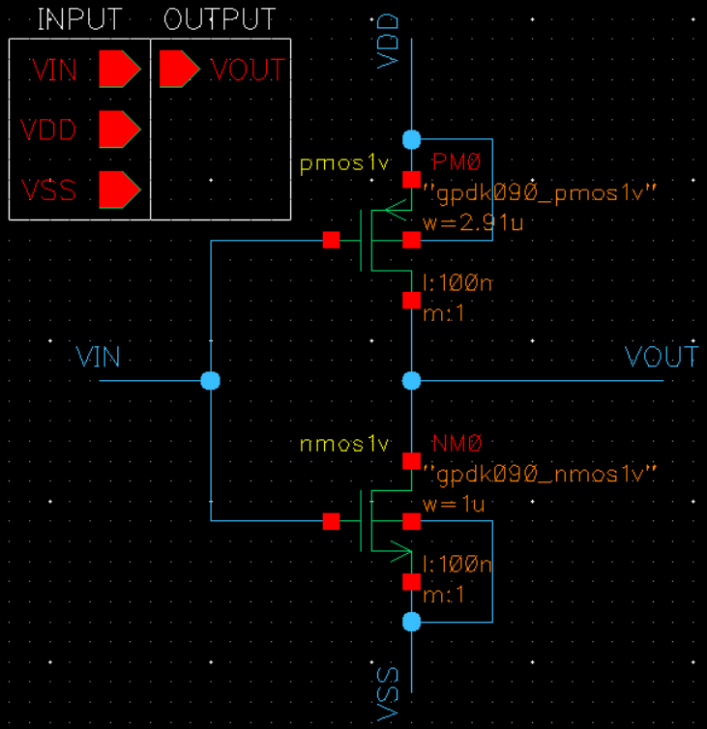
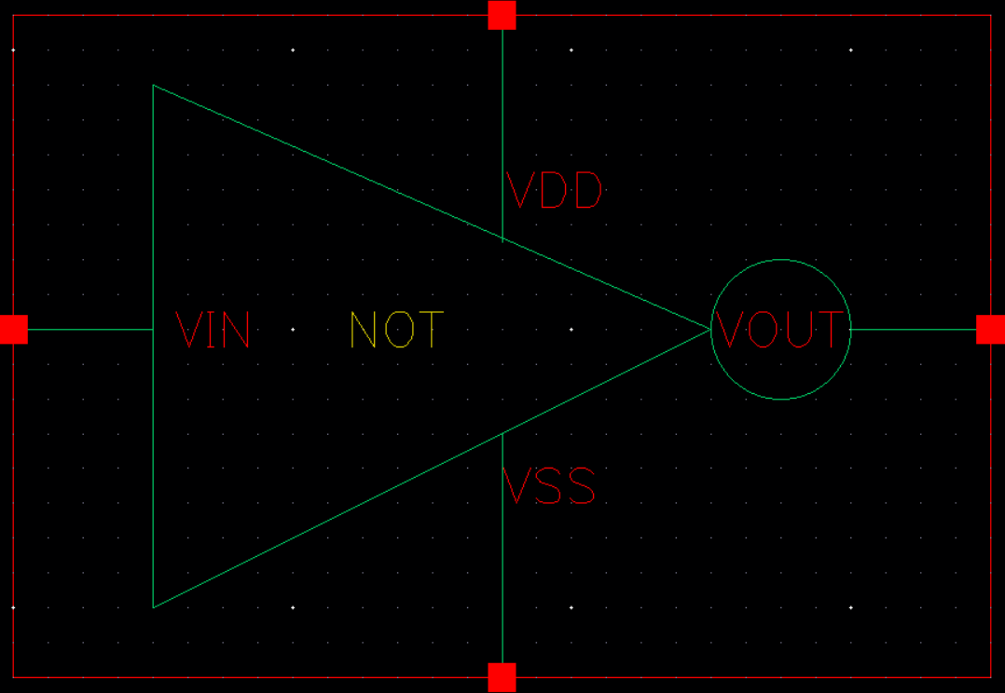
NOT – Schematic & Symbol

Slide 7
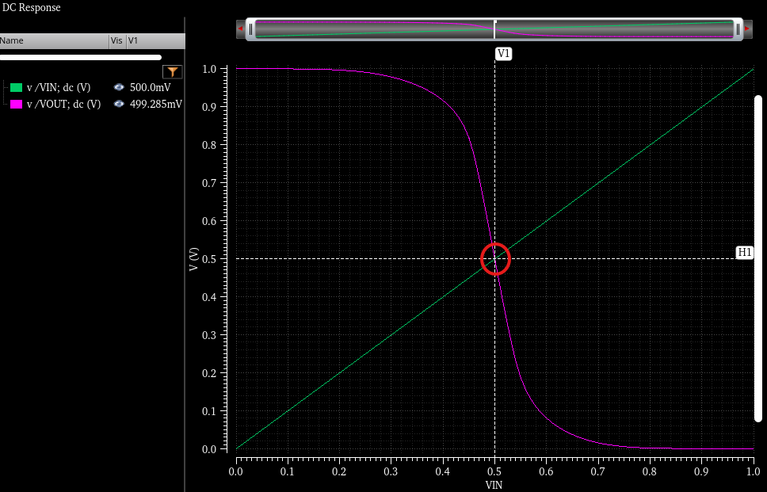
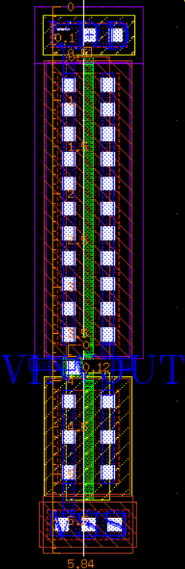
NOT – Simulation & Layout

Slide 8
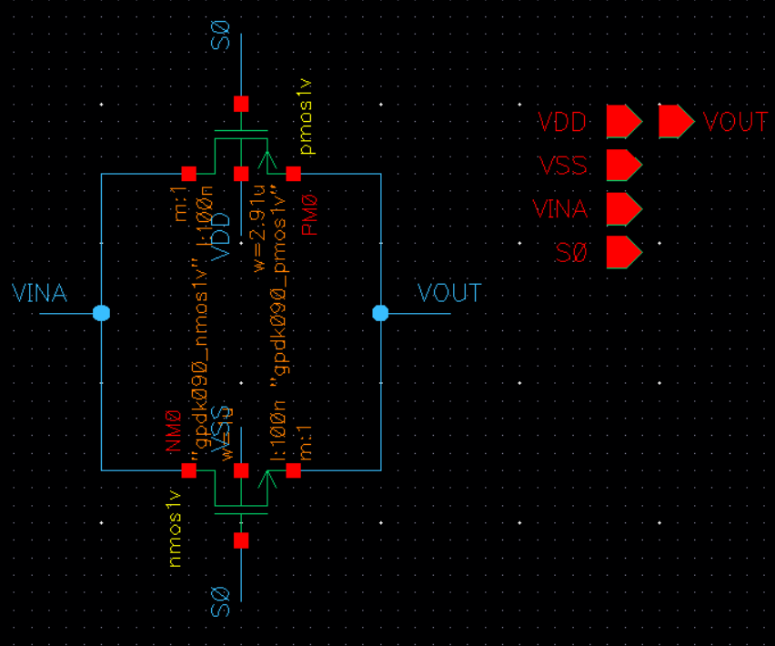
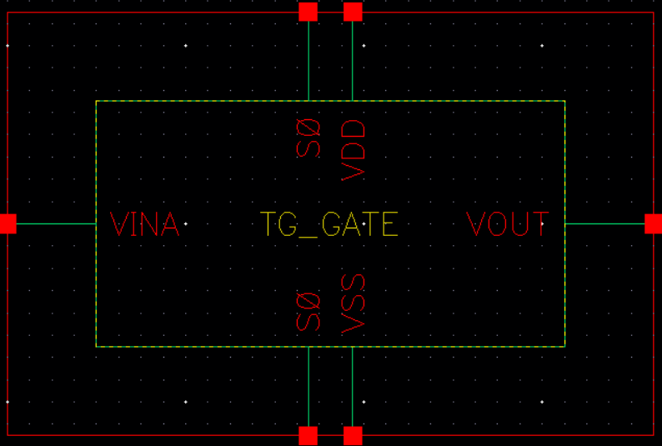
Switch - Schematic & Symbol

Slide 9
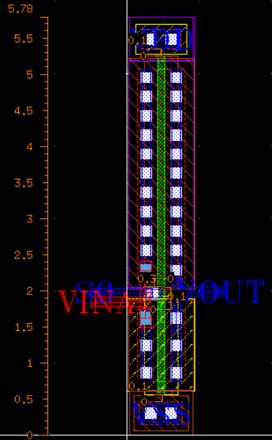
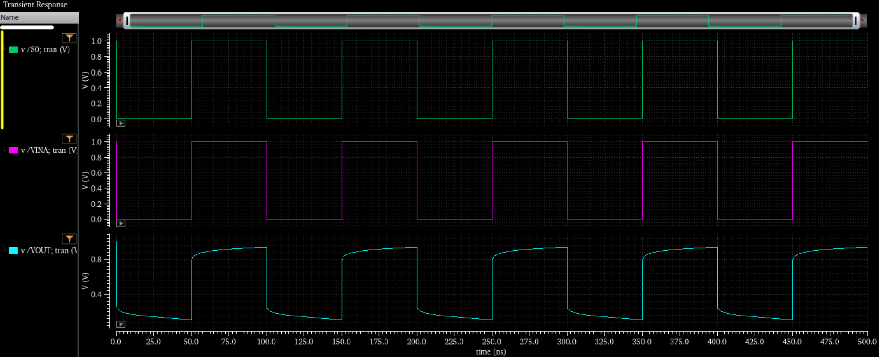
Switch – Simulation & Layout

Slide 10
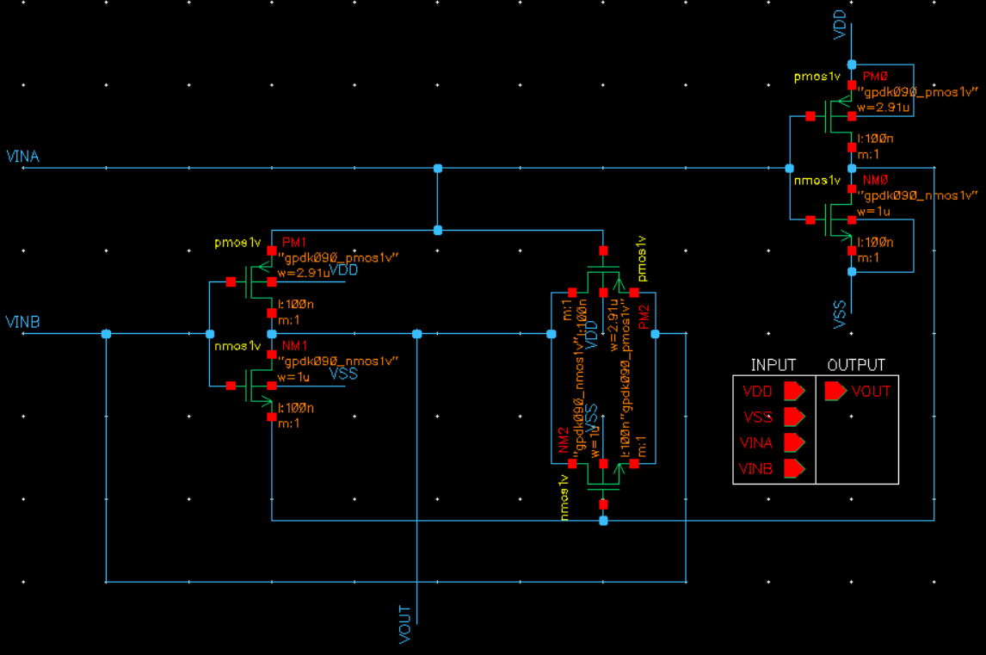
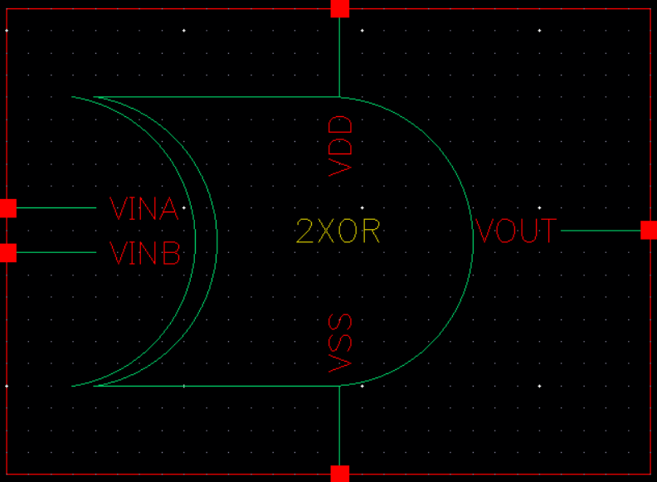
2XOR - Schematic & Symbol

Slide 11
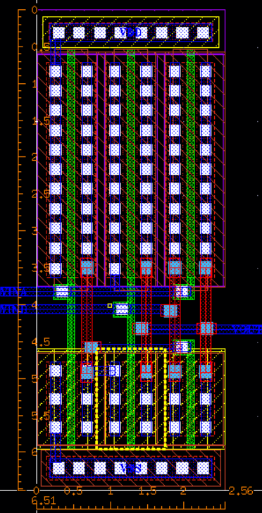
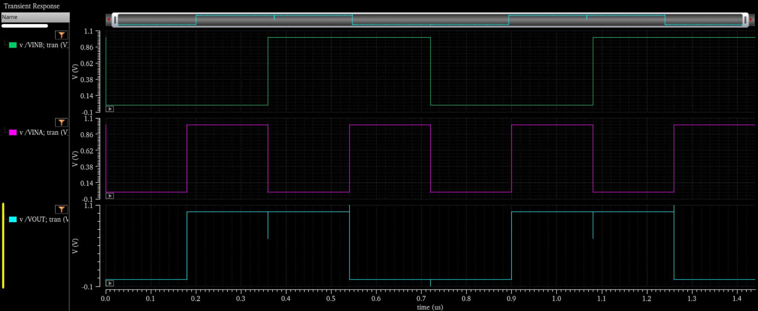
2XOR – Simulation & Layout

Slide 12
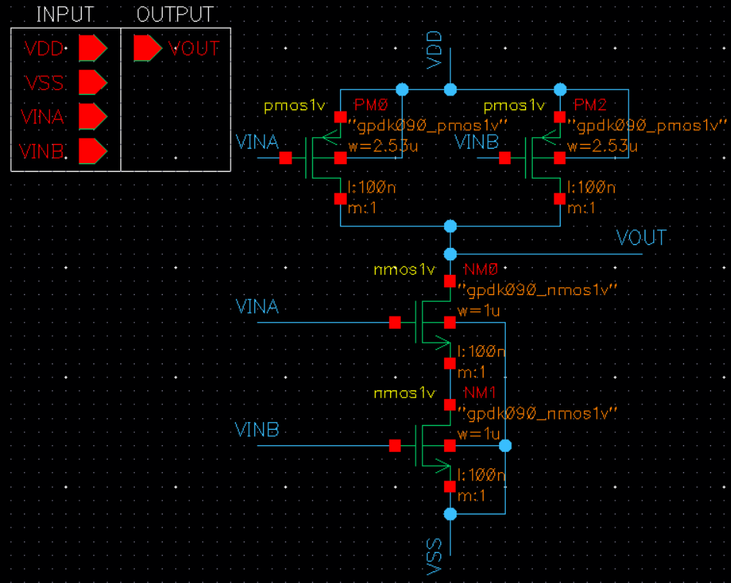
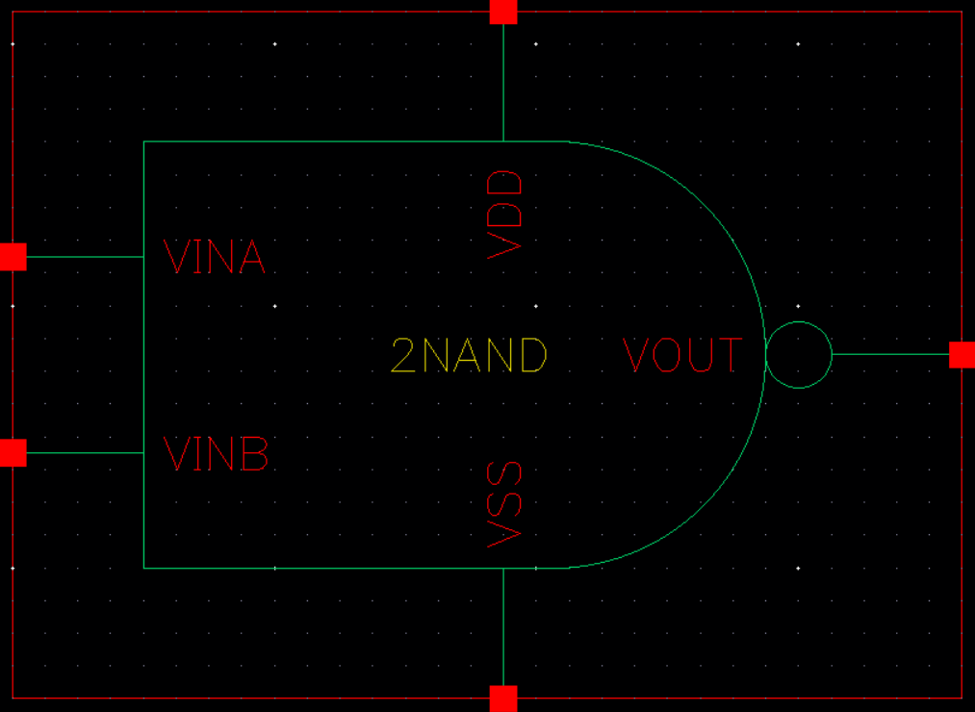
2NAND - Schematic & Symbol

Slide 13
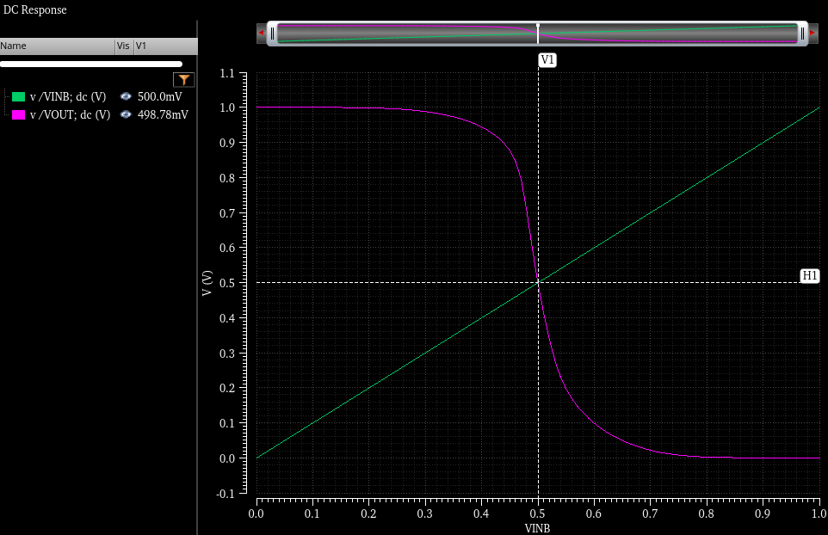
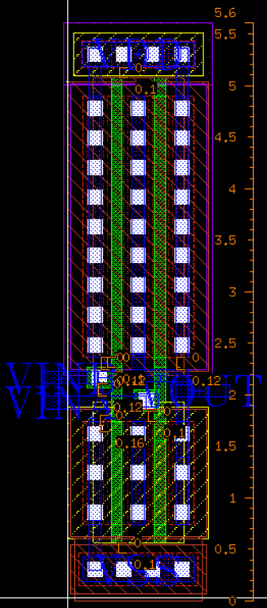
2NAND - Simulation & Layout

Slide 14
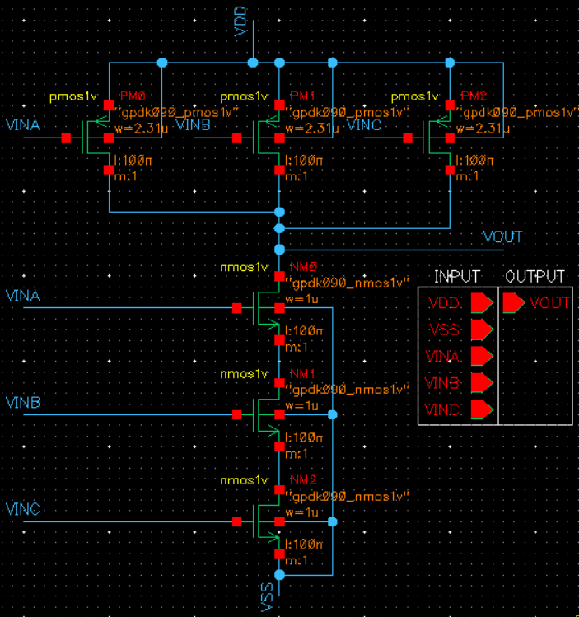
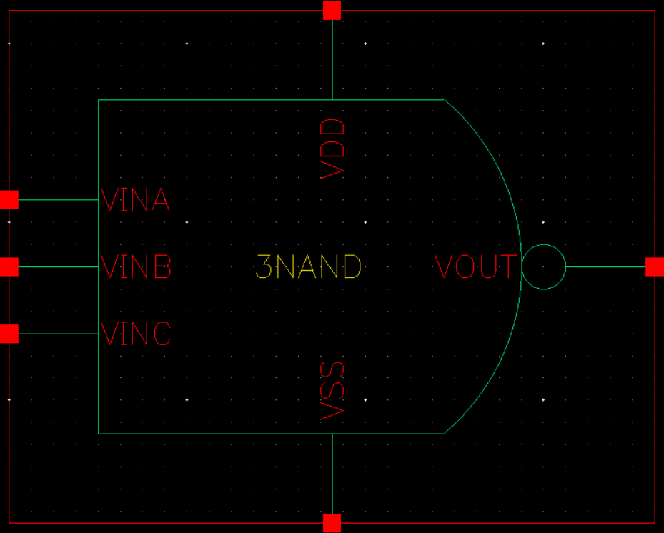
3NAND – Schematic & Symbol

Slide 15
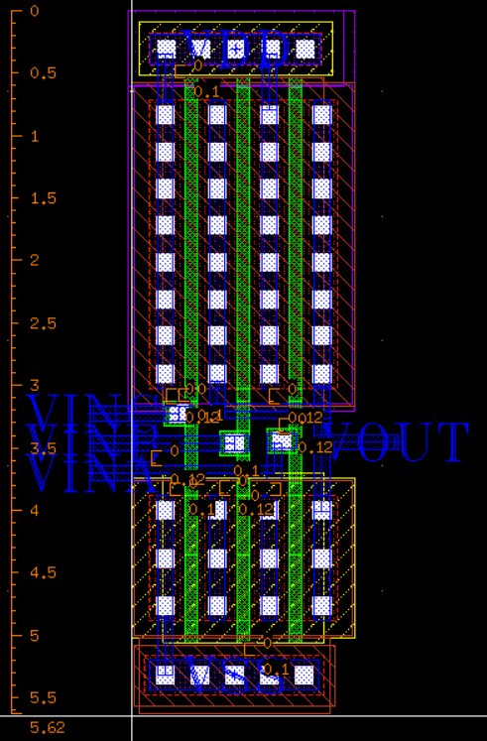
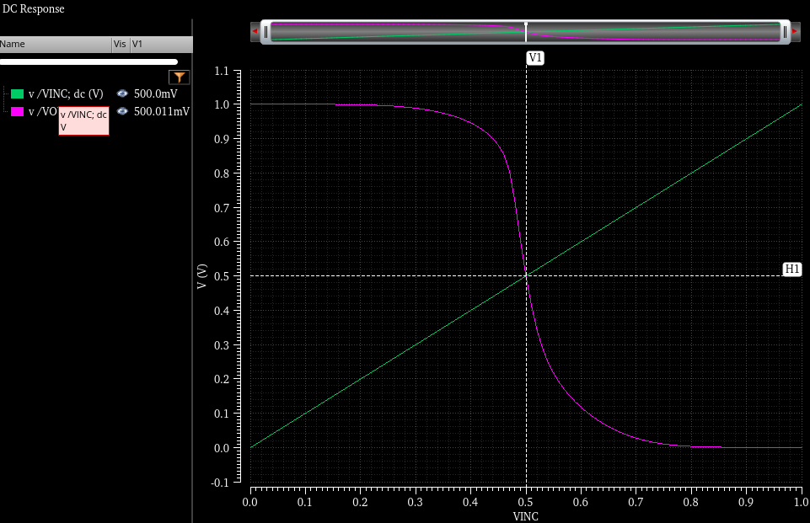
3NAND - Layout & Simulation

Slide 16
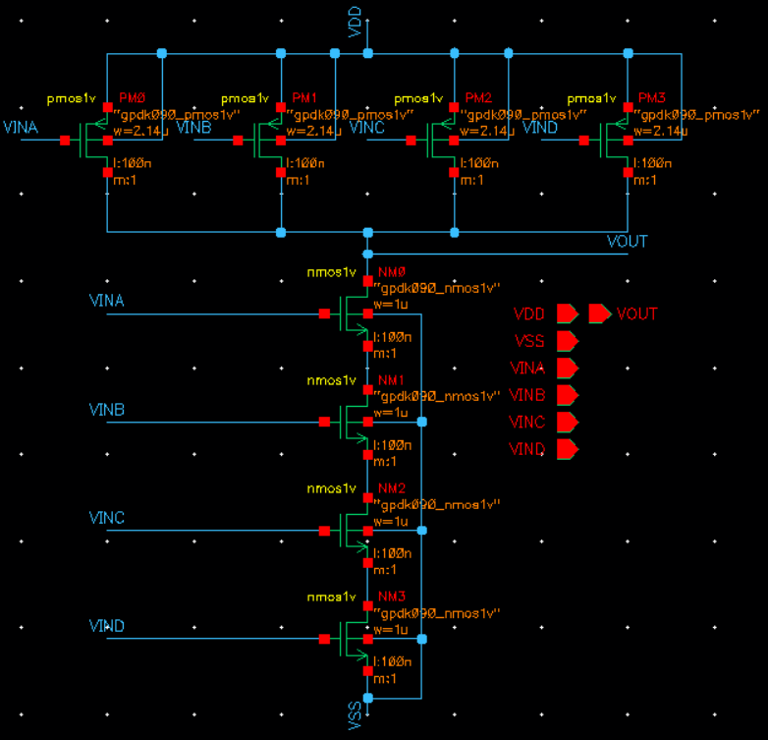
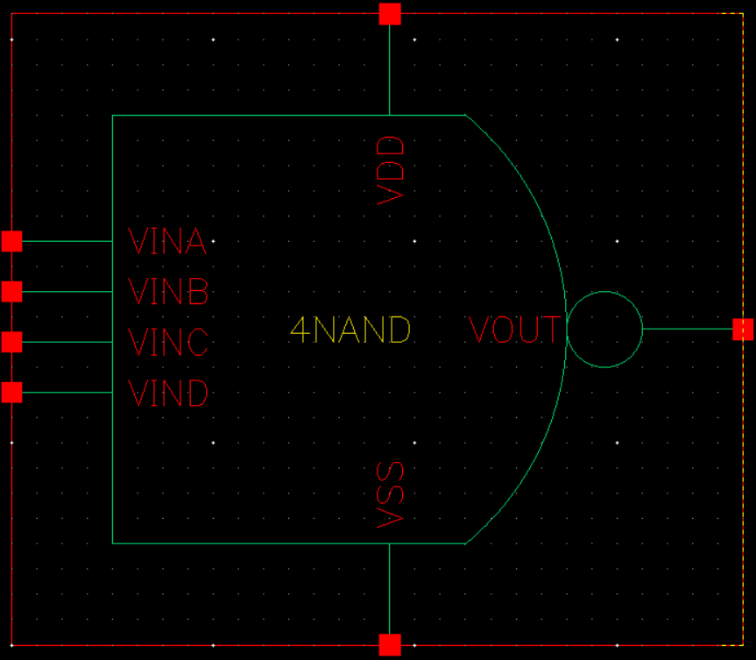
4NAND – Schematic & Symbol

Slide 17
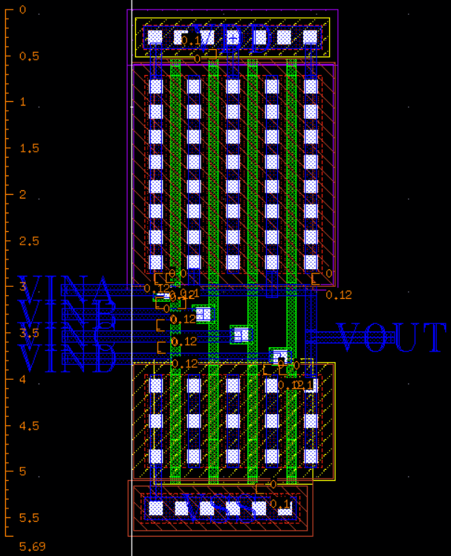
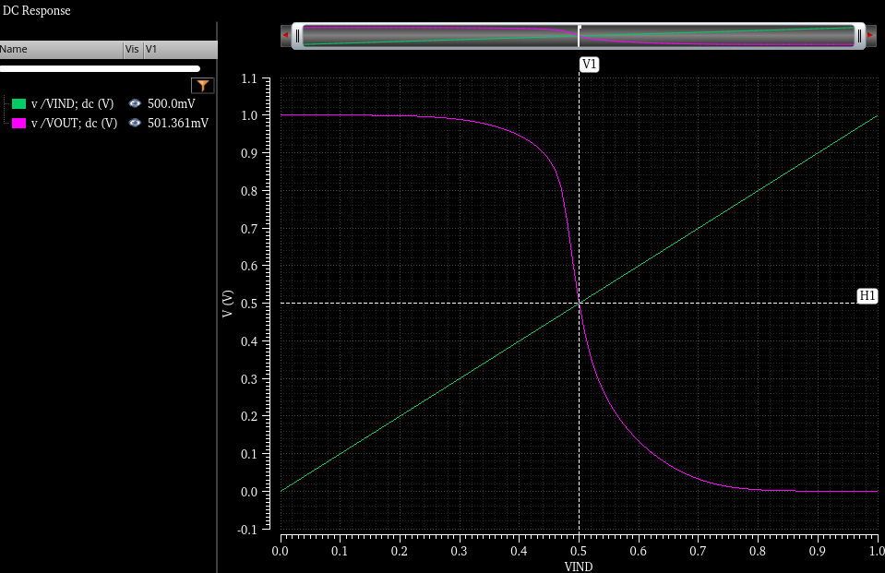
4NAND - Layout & Simulation

Slide 18
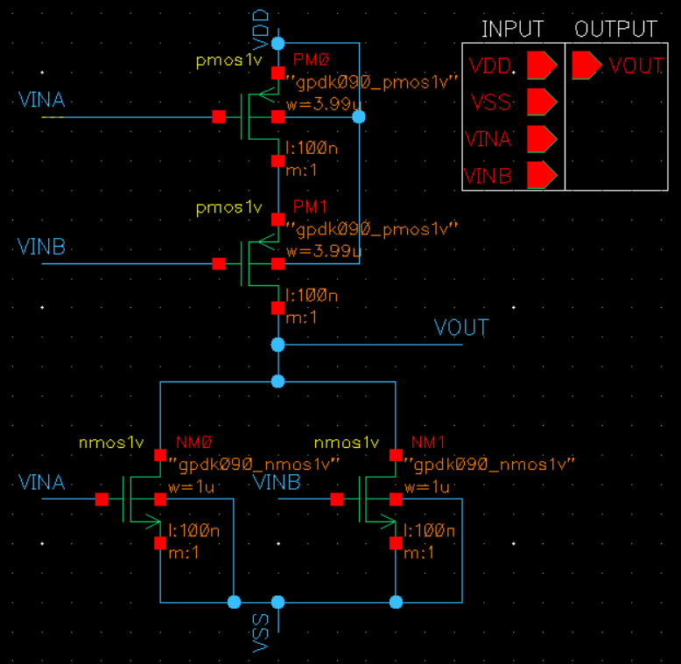
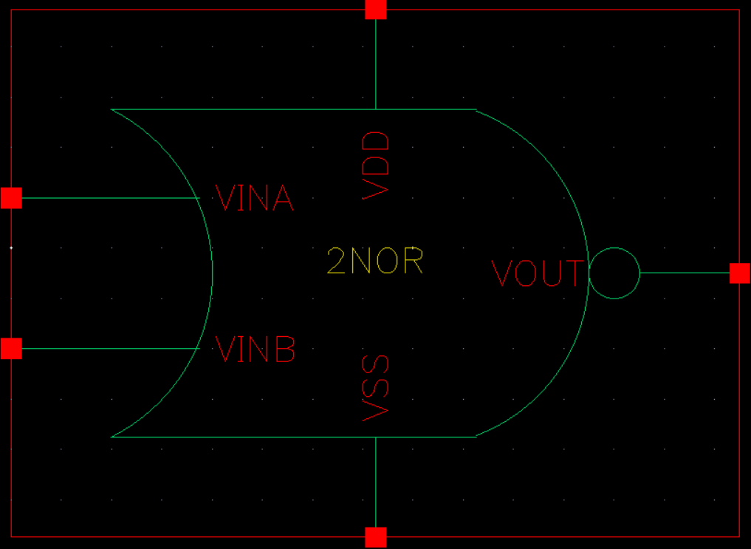
2NOR – Schematic & Symbol

Slide 19
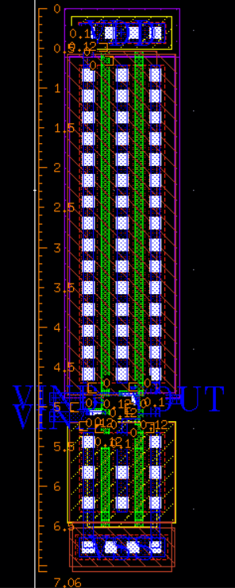
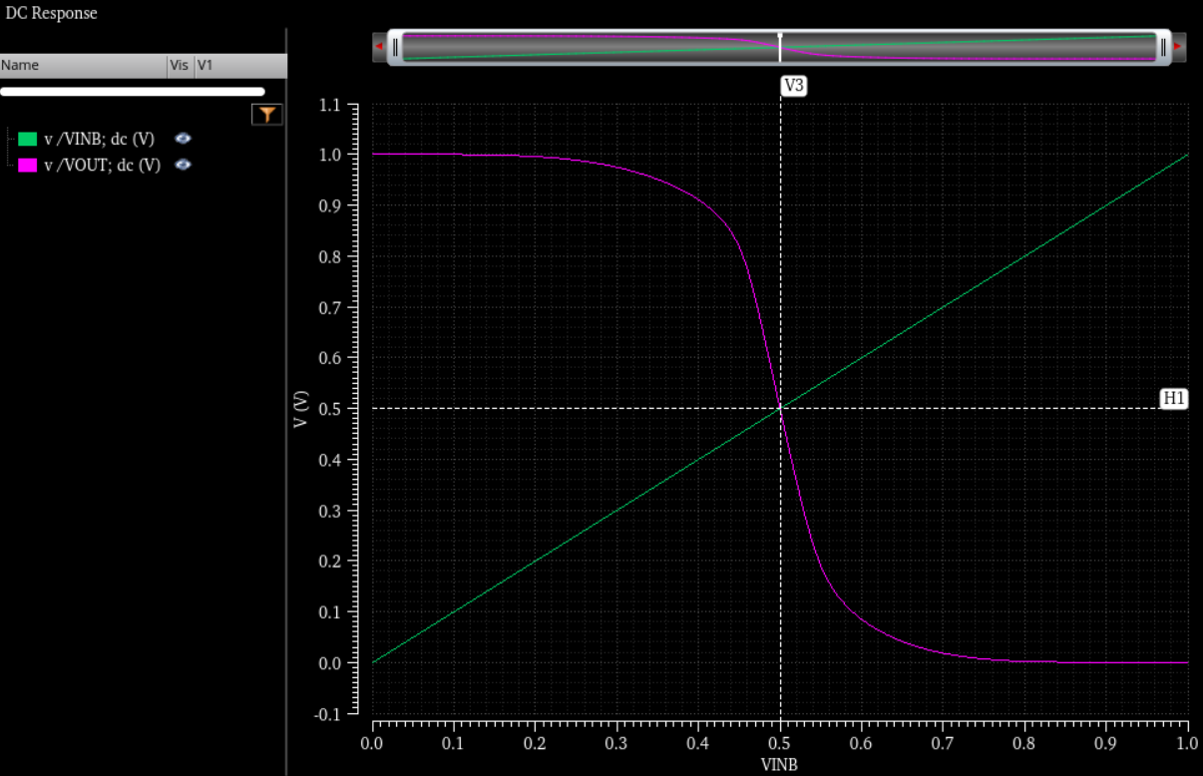
2NOR - Layout & Simulation

Slide 20
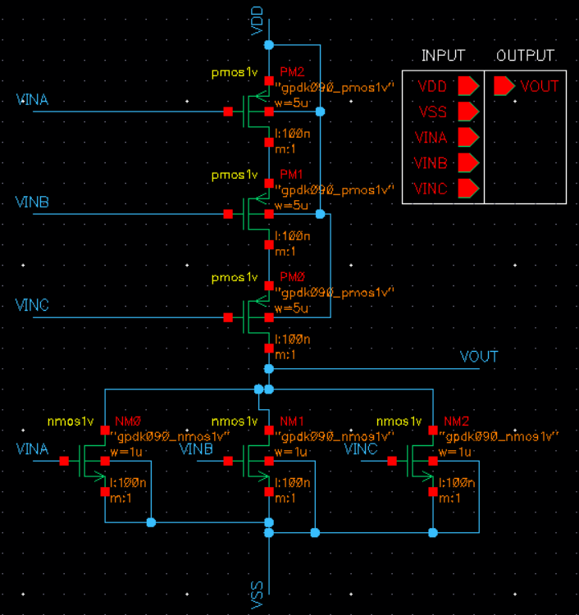
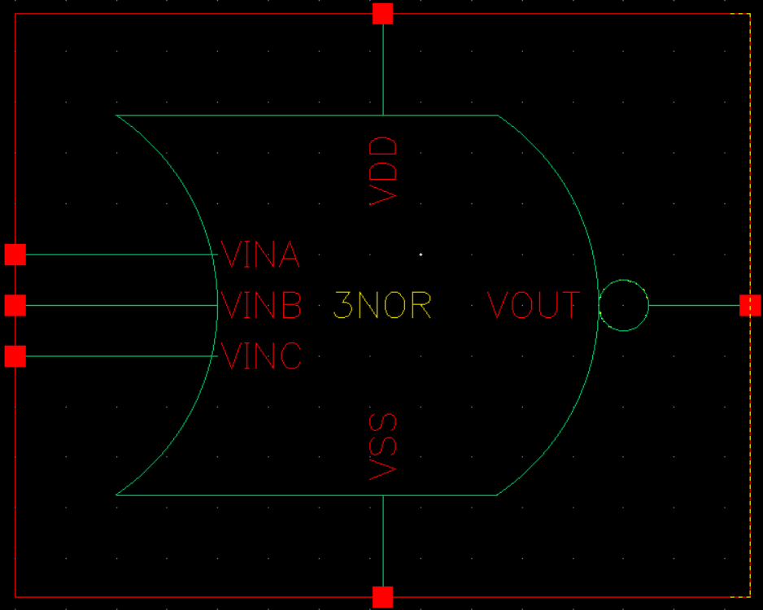
3NOR – Schematic & Symbol

Slide 21
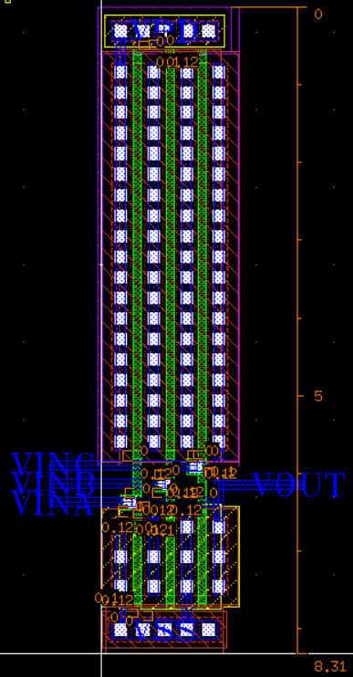
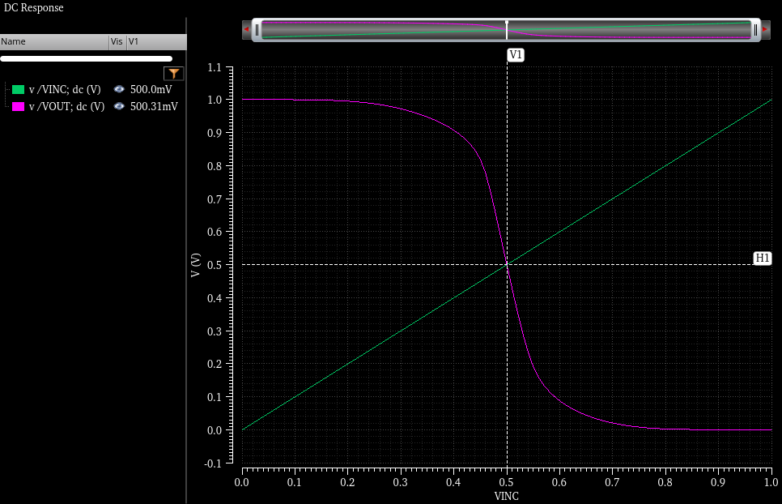
3NOR - Layout & Simulation

Slide 22
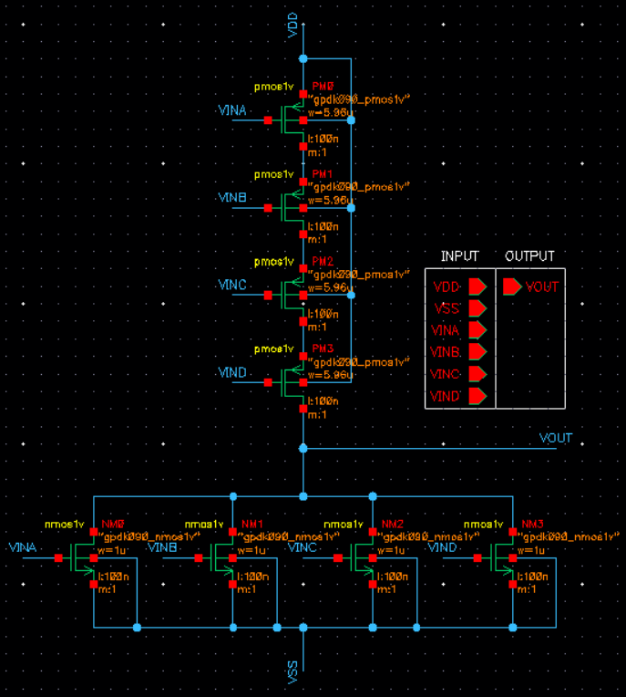
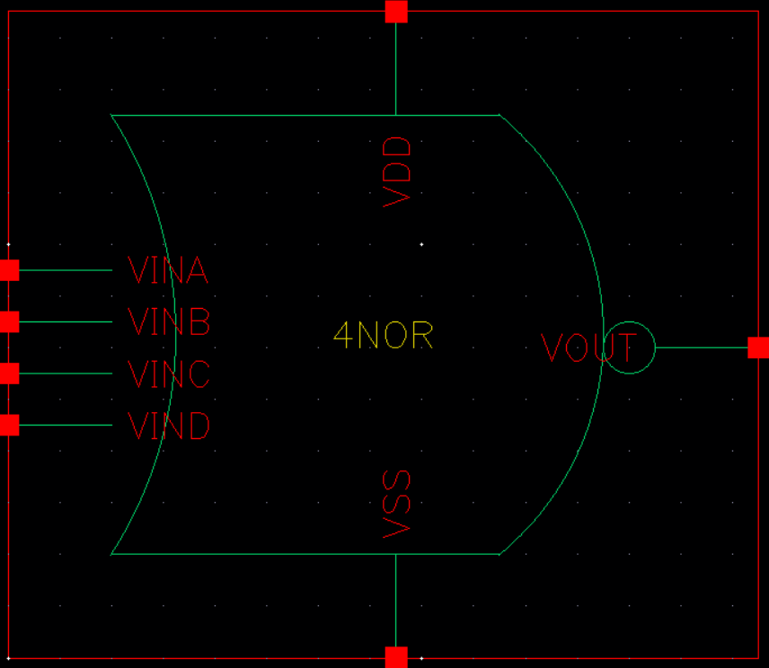
4NOR – Schematic & Symbol

Slide 23
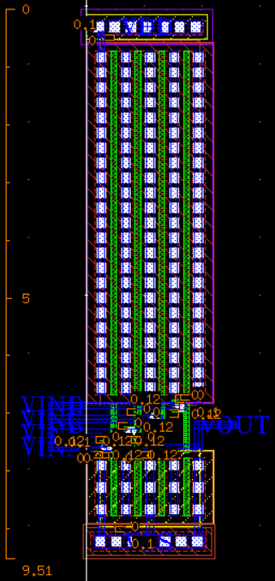
4NOR - Layout & Simulation

Slide 24
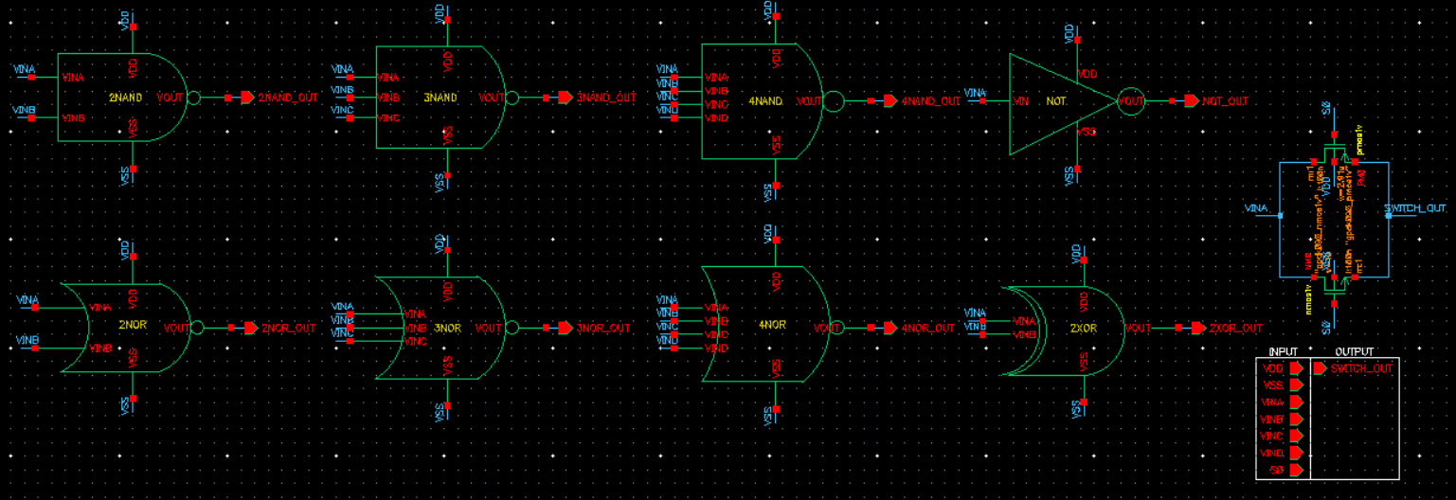
Digital Logic Gate - Schematic

Slide 25
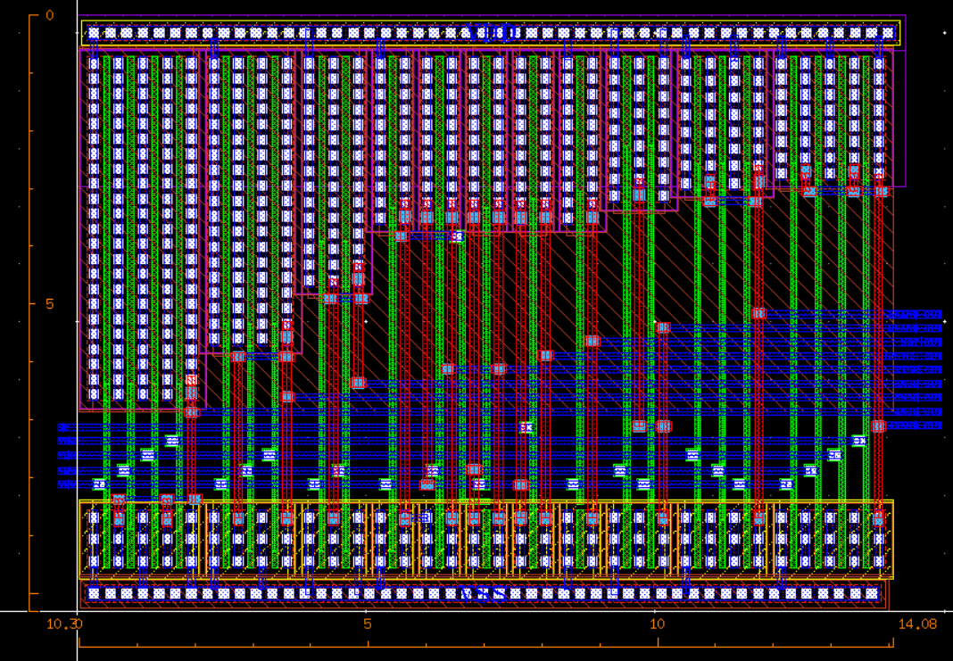
Digital Logic Gate - Layout

Slide 26
Digital Logic Gate – Schematic & Layout
Schematic
 | NOT | SWITCH | 2NAND | 3NAND | 4NAND | 2NOR | 3NOR | 4NOR
NMOS L = 100nm | 1um | 1um | 1um | 1um | 1um | 1um | 1um | 1um
PMOS L = 100nm | 2.91um | 2.91um | 2.53um | 2.31um | 2.14um | 3.99um | 5um | 5.96um
Layout
 | NOT | SWITCH | 2NAND | 3NAND | 4NAND | 2NOR | 3NOR | 4NOR
Area ($um^{2}$) | 5.4896 | 5.4332 | 7.616 | 10.0036 | 12.518 | 9.6016 | 14.7918 | 20.922

Slide 27
Digital Circuits
2x1 MUX / 4x1 MUX / 8x1 MUX / 16x1 MUX
(Difference Logic & Switch)
HALF_ADDER / FULL_ADDER / 4BIT_ADDER

Slide 28
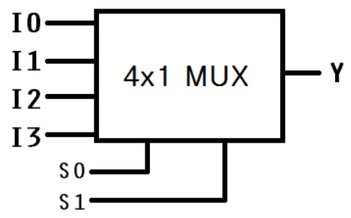
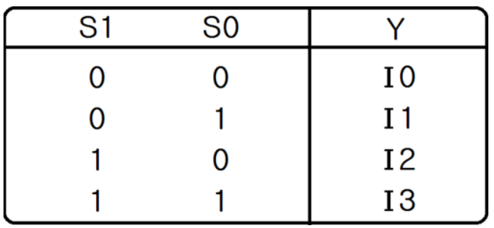
Multiplexer
Definition
- A Multiplexer (often abbreviated MUX) is a digital switching device that selects one input
signal from multiple sources and forwards it to a single output line.
General Structure
1. Multiple Data Inputs
2. Selection Lines (Control Inputs)
3. Single Output (Y)
4. Enable Signal (optional)

Slide 29
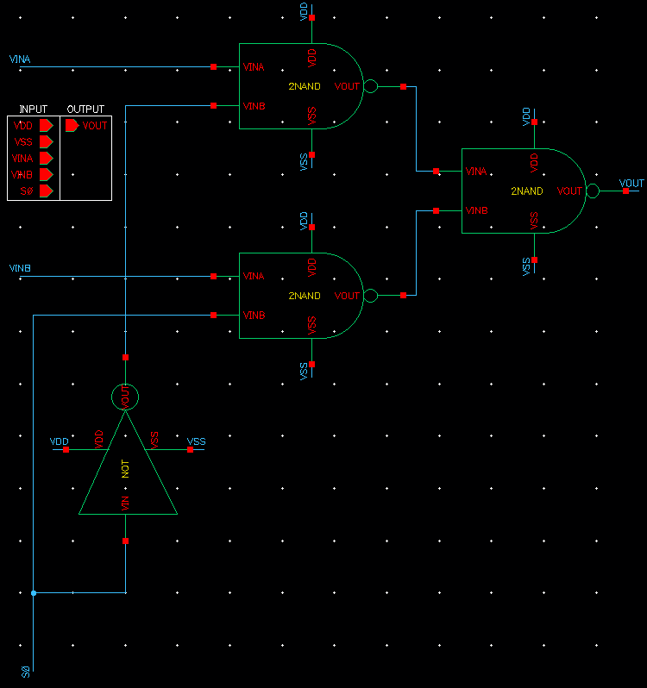
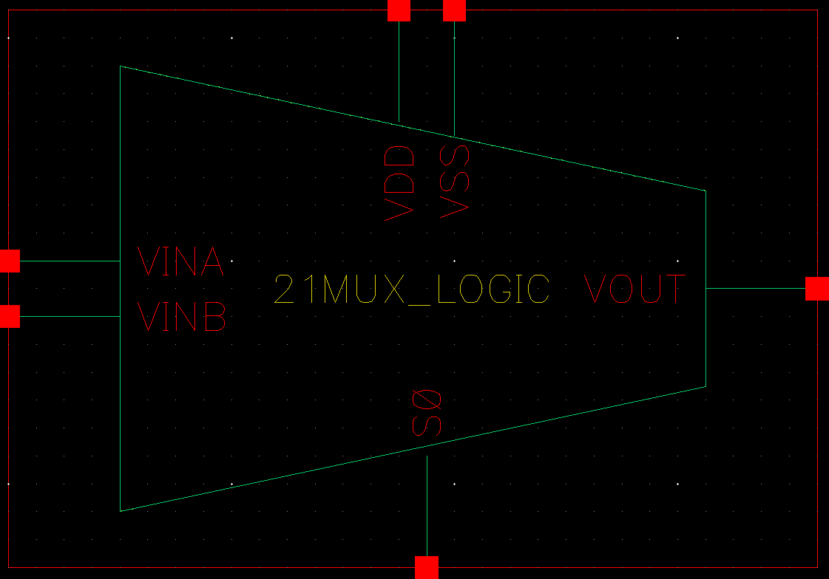
2x1 MUX Logic – Schematic & Symbol

Slide 30
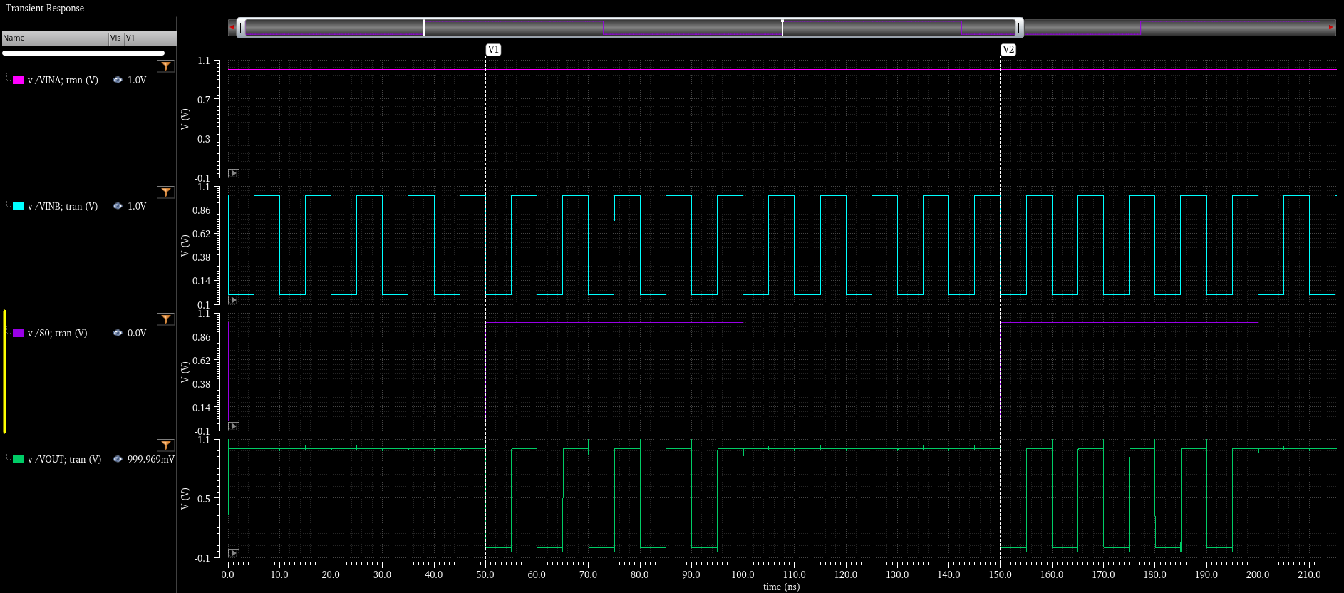
2x1 MUX Logic - Simulation

Slide 31
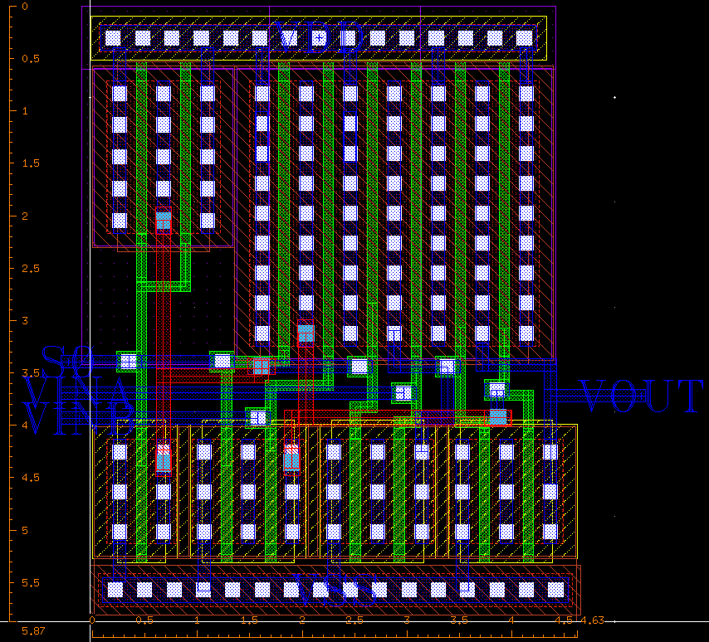
2x1 MUX Logic - Layout

Slide 32
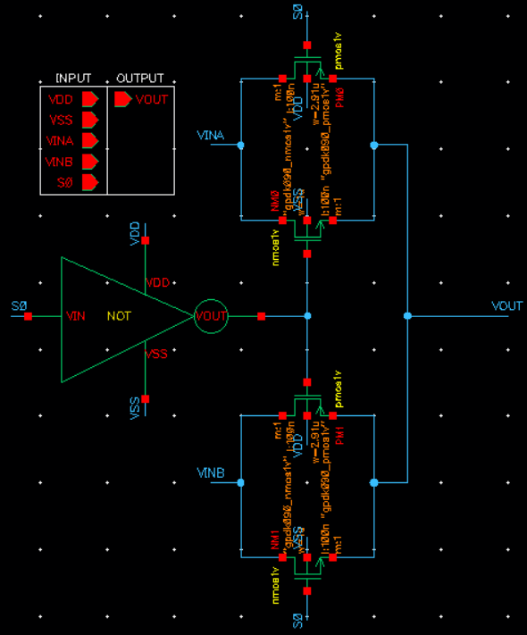
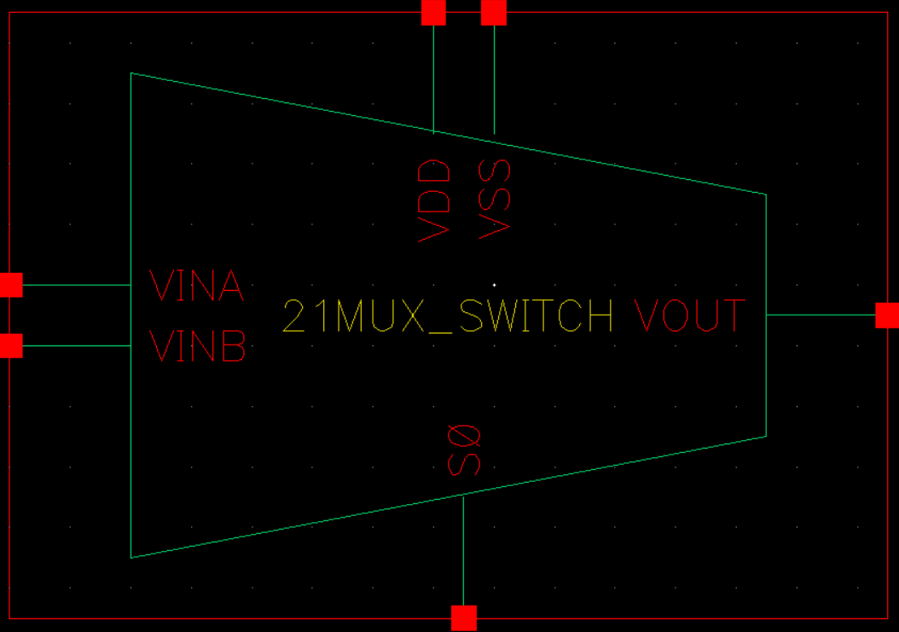
2x1 MUX Switch - Schematic & Symbol

Slide 33
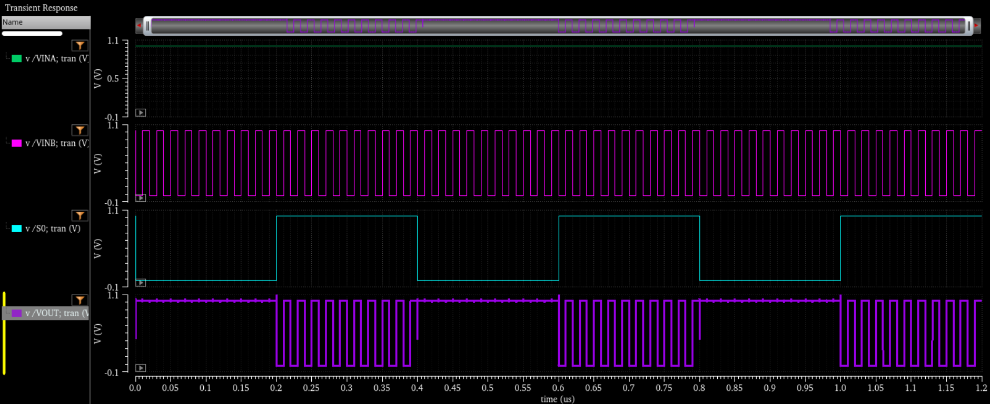
2x1 MUX Switch - Simulation

Slide 34
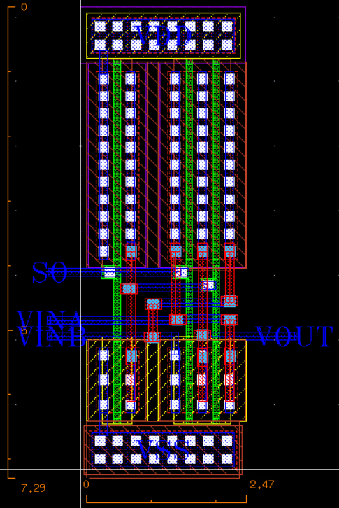
2x1 MUX Switch - Layout

Slide 35
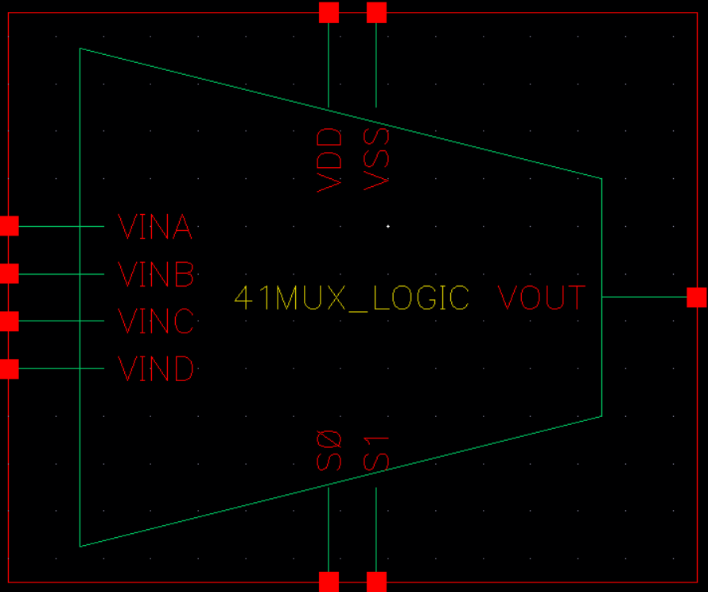
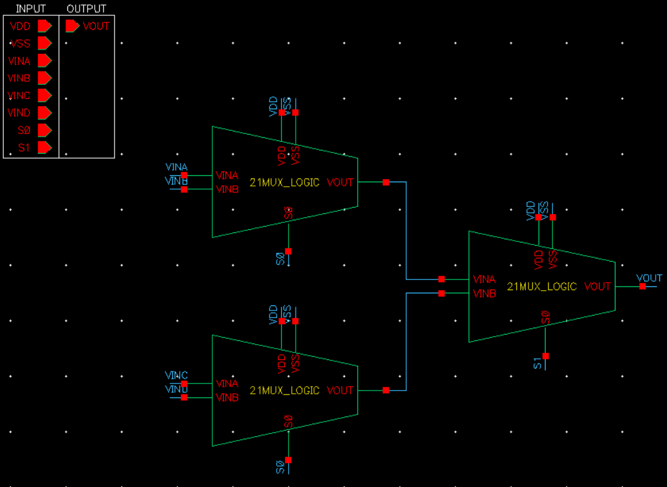
4x1 MUX LOGIC - Schematic & Symbol

Slide 36

4x1 MUX LOGIC - Simulation

Slide 37

4x1 MUX LOGIC - Layout

Slide 38


4x1 MUX SWITCH - Schematic & Symbol

Slide 39

4x1 MUX SWITCH - Simulation

Slide 40

4x1 MUX SWITCH - Layout

Slide 41


8x1 MUX LOGIC - Schematic & Symbol

Slide 42

8x1 MUX LOGIC - Simulation

Slide 43

8x1 MUX LOGIC - Layout

Slide 44


8x1 MUX SWITCH - Schematic & Symbol

Slide 45

8x1 MUX SWITCH - Simulation

Slide 46

8x1 MUX SWITCH - Layout

Slide 47


16x1 MUX LOGIC - Schematic & Symbol

Slide 48

16x1 MUX LOGIC - Simulation

Slide 49

16x1 MUX LOGIC - Layout

Slide 50


16x1 MUX SWITCH - Schematic & Symbol

Slide 51

16x1 MUX SWITCH - Simulation

Slide 52

16x1 MUX SWITCH - Layout

Slide 53

MUX(LOGIC & SWITCH)
Layout
Area ($um^{2}$) | 2X1 MUX | 4X1 MUX | 8X1 MUX | 16X1 MUX
LOGIC ($um^{2}$) | 27.1781 | 100.862 | 264.7431 | 716.2017
SWITCH ($um^{2}$) | 18.0063 | 48.6018 | 122.8788 | 305.347
Ratio | 9.1718 | 52.2602 | 141.8643 | 410.8547
It can be used efficiently due to its small area and number of transistors.
TR Number
 | 2X1 MUX | 4X1 MUX | 8X1 MUX | 16X1 MUX
LOGIC (unit) | 14 | 42 | 98 | 210
SWITCH (unit) | 6 | 16 | 38 | 78

Slide 54




ADDER
HALF_ADDER
FULL_ADDER
4BIT_ADDER

Slide 55


HALF ADDER - Schematic & Symbol

Slide 56

HALF ADDER - Simulation

Slide 57

HALF ADDER - Layout

Slide 58


FULL ADDER - Schematic & Symbol

Slide 59

FULL ADDER - Simulation

Slide 60

FULL ADDER - Layout

Slide 61


4BIT ADDER - Schematic & Symbol

Slide 62



4BIT ADDER - Simulation
First bits
1000b = 8
Second bits
1001b = 9
Final bits
0001b = 1
Carry = 1

Slide 63

4BIT ADDER - Layout

Slide 64


SUBTRACTOR
4BIT_SUBTRACTOR

Slide 65


4BIT SUBTRACTOR - Schematic & Symbol

Slide 66



4BIT SUBTRACTOR - Simulation
First bits
0111b = 7
Second bits
100xb = 8~9

Slide 67

4BIT SUBTRACTOR - Layout

Slide 68
Analog Circuits
Common Source AMP
Differential AMP

Slide 69
ANALOG CIRCUIT SPEC
Layout
 | RES | NMOS0 | NMOS1 | NMOS2 | NMOS3 | PMOS0 | PMOS1
CS_AMP | 4K | 1um | x | x | x | x | x
DIFF_AMP | 25K | 2um | 2um | 800nm | 800nm | 250nm | 250nm
TR Number
 | gm | GAIN(Av) | BANDWIDTH | POWER COMSUMPTION
CS_AMP | ~754.59[uA/V] | 6.334[dB] | 3.04[GHz] | 123.153[uW]
DIFF_AMP | ~189.955[uA/ V] | 13.448[dB] | 262.271[MHz] | 43.469[uW]

Slide 70

Common Source AMP – Schematics

Slide 71

Common Source AMP – Simulation

Slide 72

Common Source AMP – Simulation

Slide 73

Common Source AMP – Simulation

Slide 74

Common Source AMP – Layout

Slide 75

Differential AMP – Schematics

Slide 76

Differential AMP – Simulation

Slide 77

Differential AMP – Simulation

Slide 78

Differential AMP – Layout

Slide 79
Team Project
D - Flip Flop
4Bit Sync Up Counter
4Bit Shift Register(PIPO)

Slide 80

D – Flip Flop – Schematics

Slide 81

D – Flip Flop – Simulation

Slide 82

D – Flip Flop – Layout

Slide 83


4BIT SYNC UP COUNTER – Schematics

Slide 84

4BIT SYNC UP COUNTER – Simulation

Slide 85

4BIT SYNC UP COUNTER – Layout

Slide 86

4BIT SHIFT REGISTER – Schematics

Slide 87


4BIT SHIFT REGISTER – Simulation
딜레이 발생

Slide 88

4BIT SHIFT REGISTER – Layout

Slide 89

One-Chip Design – Pin Array

Slide 90

One-Chip Design - Schematics
HALF_ADDER
161MUX_LOGIC
81MUX_LOGIC
41MUX_LOGIC
21MUX_LOGIC
FULL_ADDER
21MUX_SWITCH
161MUX_SWITCH
81MUX_SWITCH
41MUX_SWITCH
4BIT_ADDER
4BIT
COUNTER
SHIFT_REGISTER
LOGIC_GATE
4BIT_SUBTRACTOR
COMMON-SOURCE
AMPLIFIER
DIFFERENTIAL
AMPLIFIER

Slide 91

One-Chip Design - Layout
Analog Circuits
Team Project
(4bit up counter & shift register)
Digital
Logic Gate
Digital Circuits

Slide 92

One-Chip Design – Layout(DRC)

Slide 93

One-Chip Design – Layout(LVS)

Slide 94


CONTACT
E-mail
s5748766@gmail.com
Phone
+82 010-9603-8799

